Slide 2
OUTLINE
Why Advent?
Advent Themes
Activities
Resources
Advertising

Slide 3
WHY ADVENT?
Finite period of time (trial)
Clear themes
Scripture readings already established
Deliberate counterpoint
Notes:
Trials: leadership, activities, resources …

Slide 4
THEME
Preparation
“Prepare the way of the Lord, make his paths straight.”
(Isaiah 40.3 and Mark 1:3)
A highway to Jerusalem (think bulldozers and elephants)
St Martin’s Lent (What’s the history? What’s the process?)
A new beginning (new year’s resolution - literally)

Slide 5
THEMES
Yearning
Give me one who yearns; … give me one far away in this desert, who is thirsty and sighs for the spring of the Eternal country. Give me that sort of man: he knows what I mean.
(Augustine of Hippo)
Advent trains us to ache again. Of all the seasons of the church year, Advent is the time to acknowledge, feel, and even embrace the joyful anguish of longing for Messiah’s birth and the world’s rebirth. So we sing our aching songs while we light candles and festoon the church with greenery. That is Advent longing, and we couldn’t imagine it any other way.
(Matthew Woodley)

Slide 6
THEMES
Hoping
A Living Hope
^{﻿3﻿} Blessed be the God and Father of our Lord Jesus Christ! By his great mercy he has given us a new birth into a living hope through the resurrection of Jesus Christ from the dead…
1 Peter 1:3
Genie hope v Jesus hope (i.e. ‘lamp-rubbing’ v ‘confident expectation’)
Hope and salvation (Romans 5:1-5 (NRSV))
³ And not only that, but we also boast in our sufferings, knowing that suffering produces endurance, ⁴ and endurance produces character, and character produces hope, ⁵ and hope does not disappoint us, because God’s love has been poured into our hearts through the Holy Spirit that has been given to us.
“Christianity has always been the hope of God through Jesus played out in the lives of real people living in real circumstances.”
(Doug Pagitt)

Slide 7
THEMES
Expectation – Incarnation
What are you expecting?
What is the incarnation?
What are the circumstances of the incarnation?
What does it mean for us?

Slide 8
ACTIVITIES
Old School: Bible Study Group (Use the Lectionary)
Angle: Social Justice (What does Advent do to Social Justice?)
Lectio Divina
Ignatian Meditation
Create a Jesse Tree (add one thing each week)
Advent Wreath (love, hope, joy, peace)
Exhibition
Congregation writes/illustrates/submits photos to an Advent study
Preparation for a Christmas day community meal
Study Group that prepares a play for Christmas Day

Slide 9
RESOURCES
Movies
Babette’s Feast (preparation)
Chocolat (preparation)
Joyeux Noel (incarnation?)
Big Night (preparation)
Hugo (recovering hope)
Truman Show (awakening to reality)
Children of Men (hope)
The Nativity Story
Love Actually

Slide 10
RESOURCES continued
Album
“Oh Light” by The Liturgists
Songs
The Sun will Rise (The Brilliance) – hope
Breathe (The Brilliance) – yearning
O Come O Come Emmanuel (BYU Vocal Point) https://www.youtube.com/watch?v=AdR79P-2ewo
Choral Music
http://www1.cpdl.org/wiki/index.php/ChoralWiki:Music_for_the_Advent_and_Christmas_season

Slide 11
RESOURCES continued
Photography
http://stpauls.org/life-together/advent-photo-project
http://adventword.org/signup/
http://www.stpaulschatham.org/event/advent-photoword-day-0
https://www.concordiatechnology.org/blog/2015/11/the-complete-guide-to-advent-photo-a-day-challenges

Slide 12
RESOURCES continued
Books: https://www.churchpublishing.org/adventchristmas
Advent Presence: Kissed by the Passed, Beckoned by the Future by Melford “Bud” Holland (2015) (This also has a poster calendar sold in packets of 25 for congregational distribution to mark the days of Advent with devotions. Sold separately.)
A Thrill of Hope: The Christmas Story in Word and Art - DVD and study guide using the artwork of John August Swanson (2011)
Teach Us to Number the Days: A Liturgical Advent Calendar by Barbara Dee Baumgarten (1999)
Come Thou Long-Expected Jesus: Advent and Christmas with Charles Wesley by Paul Wesley Chilcote (2007)
Advent with Evelyn Underhill edited by Christopher L. Webber (2006) Run, Shepherds, Run: Poems for Advent and Christmas compiled by L. William Countryman (2005)

Slide 13
RESOURCES continued
Books
From Holidays to Holy Days: A Benedictine Walk through Advent by Albert Holtz, O.S.B. (2008)
Light to the Darkness: Lessons and Carols, Public and Private by Katerina Whitely (2008)
Waiting for the Wonder: Voices of Advent by Katerina Katsarka Whitley (2008)
The Womb of Advent by Mark Bozzuti-Jones (2007)
Times and Seasons: Creating Transformative Worship Throughout the Year by Richard Giles (2008)
Mary and Her Miracle: The Christmas Story Retold by Barbara Cawthorne Crafton (2007)
Love Came Down: Anglican Readings for Advent and Christmas by Christopher L. Webber (2002)

Slide 14
RESOURCES continued
Books
Let Every Heart Prepare: Meditations for Advent and Christmas by Barbara Cawthorne Crafton (1998)
Our December Hearts: Mediations for Advent & Christmas by Anne McConney (1999)
The Christmas Tide by Frederick Buechner (2005)
Songs in Waiting: Spiritual Reflections on Christ’s Birth by Paul-Gordon Chandler (2009)
Come, Lord Jesus! Daily Readings for Advent, Christmas and Epiphany by Geoffrey Rowell and Julien Chilcott-Monk (2003)
Stations of the Nativity: Meditations on the Incarnation of Christ by Raymond Chapman (1999)

Slide 15
RESOURCES continued
Poetry
The Second Coming (WB Yeats)
Index of Poets and Poetry
http://www.journeywithjesus.net/poetry/poetry-index?jwjpoetrygenre=1
Art Strategies
The Contrast
The Reflection
The Anachronism
The Mystery

Slide 16
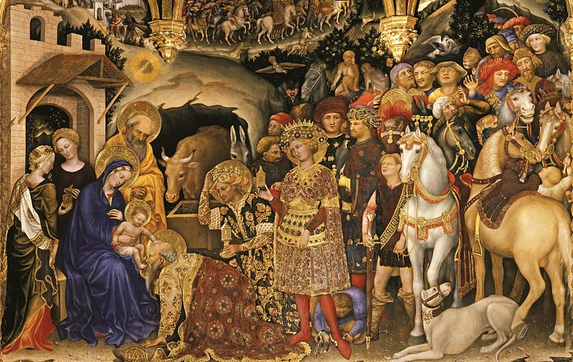
Notes:
Gentile da Fabriano

Slide 17
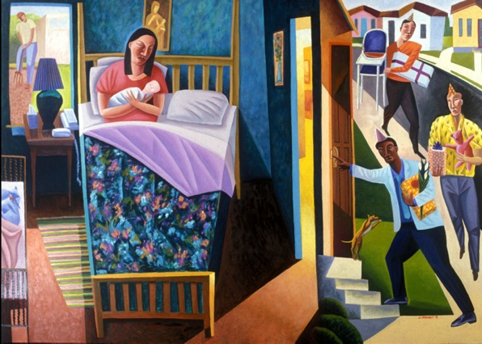
Notes:
James B. Janknegt, Nativity, 1995

Slide 18
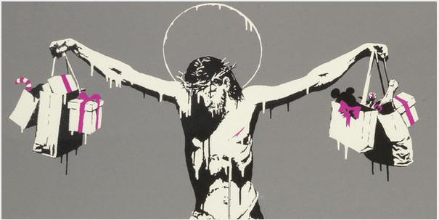
Notes:
Banksy 2005

Slide 19
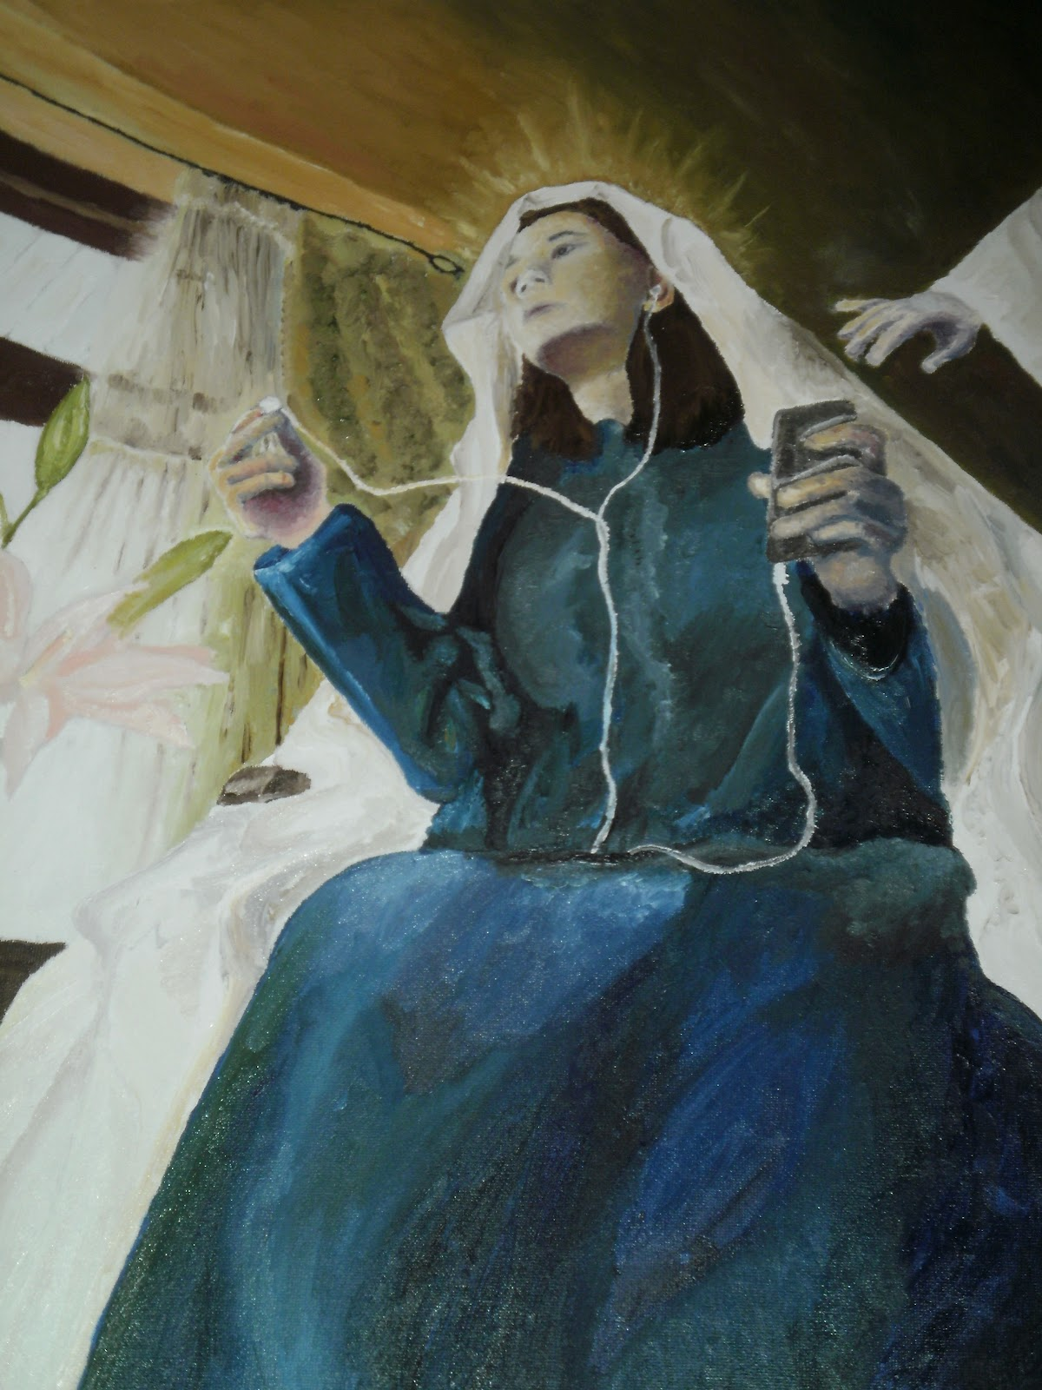

Slide 20
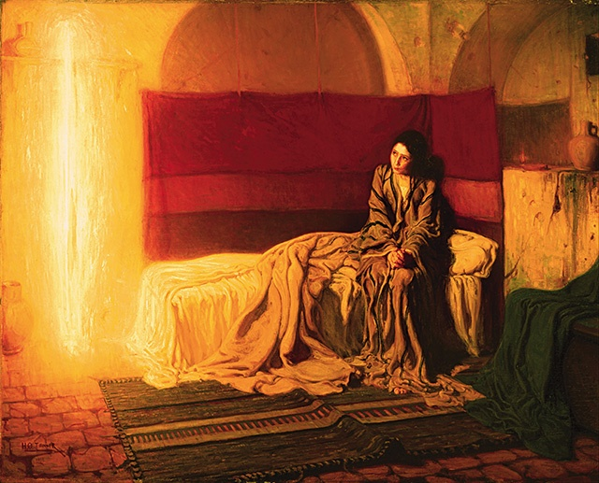
Notes:
Henry Ossawa Tanner The Annunciation 1898

Slide 21
Advertising
Context
Audience
Purpose

